Slide 1

Environmental Management System Based on
ISO 14001:2015

Slide 2

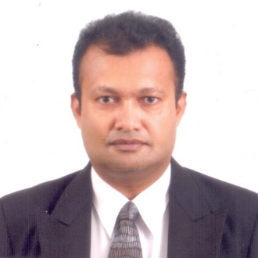




In House Team
Chaminda Karunanayake
-Director Business Development –
(MSc Herriot Watt, MBA-USQ, PhD candidate (Sri Jaya))
Sugath Hettiarachchi
-Director System implementation-
(DOSH, DQA, Lead Auditor EMS,QMS, OHMS, BSc-Colombo)
Madusha Sewwandi
-QA & Project Lead-
(HND-Food Science)
Isuru Denagamage
-Marketing & Brand Executive
(BSc (Hons) in Agriculture, PGdip Marketing (SLIM) )
Asheni Silva
-Compliance Specialist-
(LLB-UK, LLM-Candidate)
Pravinda Bhagya
-Consultant-
BSc, MSc, PhD(Candidate-Aus)

Slide 3















Our Experience

Slide 4
What is Environmental Management System
An Environmental Management System (EMS) is a set of processes that enable an organization to reduce its environmental impacts and increase its operating efficiency through out organization.

Slide 5
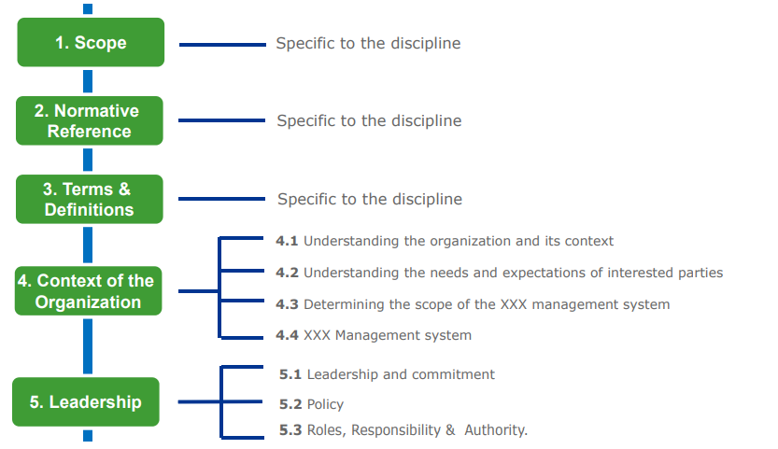
IS0 14001- HIGH LEVEL STRUCTURE

Slide 6
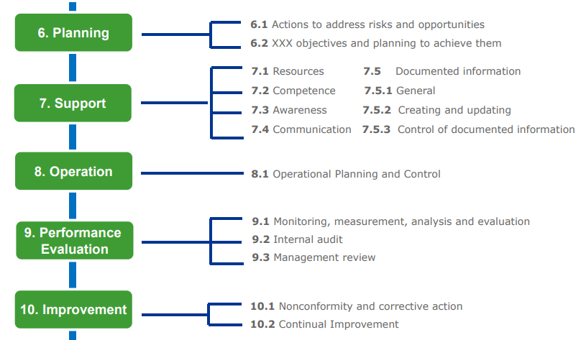
IS0 X- HIGH LEVEL STRUCTURE CONT..

Slide 7
Clause No:04
4.4
Environmental mgt system
4.1 understanding the organization & it’s context
4. Context of the Organization
4.3
Determining scope of the Environmental mgt system
4.2 understanding needs & expectation of interested parties

Slide 8
Clause No:05
5.1
Leadership & commitment
5. Leadership
5.2
Policy
5.3
Roles, responsibility & authority

Slide 9

Clause No:06
6.2
Environmental objectives & planning to achieve them
6. Planning
6.1
Actions to address risks & opportunity

Slide 10
Clause No:07
7.2
Competence
7.3
Awareness
7.1
Resources
7. Support
7.5.1 general
7.4 Communication
7.5
Documented information
7.5.2 creating & updating
7.5.3 control of documented information

Slide 11
Clause No:08
8.Operations
8.1
operational planning & control

Slide 12
Clause No:09
9. Performance evaluation
9.1
Monitoring, measurement, analysis & evaluation
9.3
Management review
9.2
Internal audits

Slide 13
Clause No:10
10.1
Non conformity & corrective action
10. Improvement
10.2
Continual improvement

Slide 14
NEW AND OBSOLETE REQUIREMENTS OF IS0 14001:2015 (COMPARED TO 2004)
Old requirements
New requirements
4 Clauses
10 Clauses
12 mandatory
documents and records
16 mandatory
documented information
Management Representative
Preventive Action
Environmental targets ×
Context of the organization (clause 4)
Actions to address risks and opportunities (clause 6.1)
√

Slide 15
2004 Vs 2015 REVISION
14001:2015 SIMILARITIES AND DIFFERENCES
Major |  | Risk and opportunities
 |  | Context of the organization
 |  | Interested parties
Moderate |  | Identification and evaluation of environmental aspects
 |  | Environmental objectives and plans for achieving them
 |  | Emergency preparedness and response
 |  | Performance evaluation
 |  | Document management
 |  | Communication
 |  | EMS scope
Small |  | Environmental policy
 |  | Leadership
 |  | Competence, training and awareness
 |  | Management review
 |  | Internal audit
 |  | Corrective action
4 Clauses
4 Clauses
10 Clauses

Slide 16
CONCEPT OF AUDITOR COMPETANCE
(7.2.3.2)
Quality
Specific knowledge and skills
Environ management specific knowledge and skills
(7.2.3.3)
Education
Work Experience
Auditor Training
Audit Experience
(7.2.2)

Slide 17
OVERVIEW OF TYPICAL AUDIT ACTIVITIES
SOURCE OF INFORMATION
COLLECTING BY APPROPRIATE SAMPLING
AUDIT EVIDANCE
EVALUATING AGAINST AUDIT CRITERIA
AUDIT FINDING
REVIEWING
AUDIT CONCLUSIONS

Slide 18
REPORT WRITING, PRESENTATION AND FOLLOW UP AUDITS
NC CLASSIFICATION BY CERTIFICATION BODY
2. NC CLASSIFICATION BY INTERNAL HPLC INTERNAL AUDIT PROCEDURE
3. IDENTIFYING AND REPORTING NCs –
INDIVIDUAL / GROUP EXCERSISE !!

Slide 19



CONTINUATION AS AN ASSESROR
0094 773442242,
info@winyana.com support@isoconsultancy.lk
# 40, Templers Lane, Colombo 03, Sri Lanka

